Slide 1
ENSE 470, Milestone 1
DCC
Dakota Fisher, Chengyu Lou, Connor Meredith
January 18, 2018

Slide 2
Current state Value Stream Map (VSM)
Include an image of your group’s VSM
Be prepared to discuss:
Process flow (and types)
Kaizen bursts (TIMWOOD themes)

Slide 3
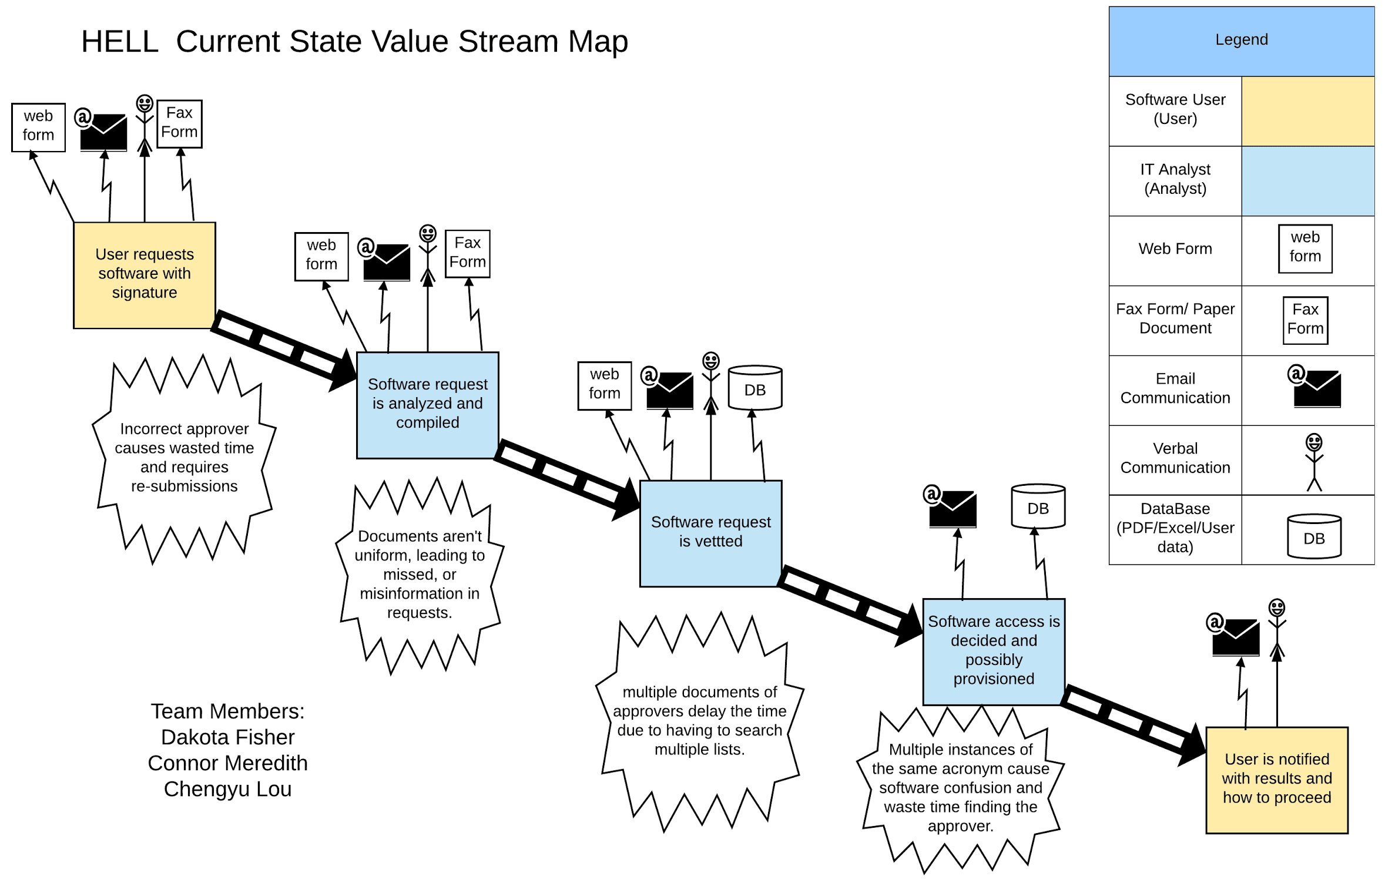

Slide 4
Group reflection
How did you feel about this milestone? What did you like about it? What did you dislike?
Likes
Requirements were clearly defined
Appropriate amount of time was provided
Dislike
Difficult to split up the work
What did you learn about yourself as you collaborated and worked through this milestone?
Plenty of types of waste in everyday life are often overlooked
Importance of being flexible and open to change

Slide 5
Group reflection
How will you use what you have learned going forward?
Minimize sources of waste
Improve future processes
What “stuff & things” related to this milestone would you want help with?
Some waste seems inevitable, so what is an acceptable amount of waste if it exists?

